Slide 1

AWS Batch
“Fully Managed Batch Processing at Scale”

Slide 2
AWS Batch Introduction
GPU Processing
Dynamic
Automated
Resources are chargeable, batch itself is not.
Notes:
AWS Batch allows the easy and efficient use of batch computing jobs on AWS.
Dynamically provisioned, and running hundreds of thousands computing jobs, AWS Batch balances optimal quantity and type of computational resources (e.g., CPU or memory optimized instances) dependent on the volume and requirements of the batch jobs submitted.
No need to install and manage batch computing software or server clusters, can simply focus on analyzing results and solving problems. AWS Batch plans, schedules, and executes your batch computing workloads across the full range of AWS compute services and features, such as AWS Fargate, Amazon EC2 and Spot Instances.
There is no additional charge for AWS Batch. You only pay for the AWS resources (e.g. EC2 instances or Fargate jobs) you create to store and run your batch jobs.

Slide 3
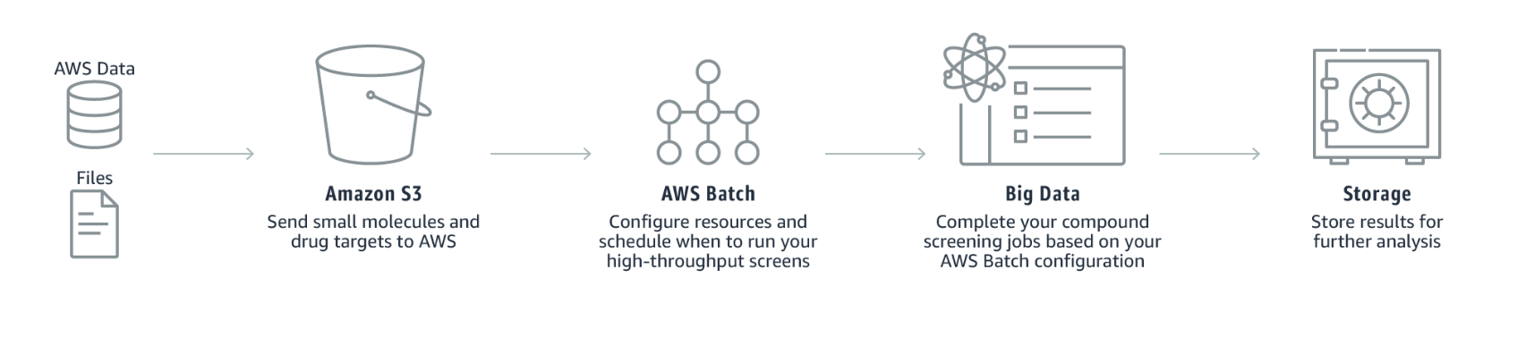
Use Cases
Drug Discovery
Notes:
The data or files are sent to Amazon S3 then the relevant small molecules and drug data to AWS.
AWS batch then configures the given resources and schedules the timing of when to run high-throughput screens.
After scheduling, big data will complete your compound screening jobs based on your AWS batch configuration.
The results are again stored for further analysis.

Slide 4
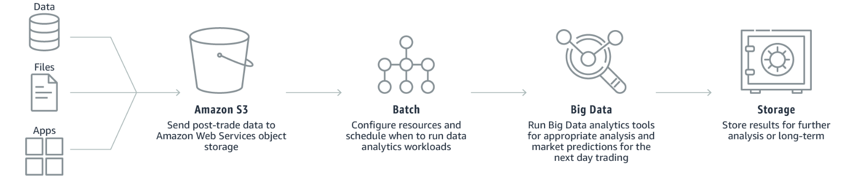
Use Cases cont’d
Automating financial analysis
Notes:
Send data, files, and applications to Amazon S3 where it sends the post-trade data to AWS object storage.
AWS Batch configures the resources and schedules the timing of when to run data analytics workloads.
After that, you have to run big data analytics tools for appropriate analysis and market predictions for the next day’s trading.
Then, the next big step is to store the analyzed data for long-term purposes or even for further analysis.

Slide 5
Features
Dynamic Compute Resource Provisioning and Scaling
Priority-based Job Scheduling
Support for GPU Scheduling
Integrated Monitoring and Logging
And more!
Notes:
A complete queue, scheduler, and compute architecture but you need not worry about managing a single piece of computing infrastructure.
Set up a number of queues with different priority levels. Unless the compute resources are available to execute the next job, the batch jobs are stored in queues. The AWS Batch scheduler is responsible for deciding when, where, and how to run the batch jobs that have already been submitted to a queue based on the resource requirements of the job.
Allows you to specify the number and type of accelerator that your jobs require as job definition input variables in AWS Batch. AWS Batch will scale up instances appropriate for your jobs based on the required number of GPUs and isolate the accelerators according to each job’s needs so that only the appropriate containers can access them.
Displays key operational metrics for your batch jobs in AWS Management Console. You can view metrics related to computing capacity as well as running, pending, and completed jobs. Logs for your jobs, e.g., STDERR and STDOUT, are available in AWS Management Console; the logs are also written Amazon CloudWatch Logs
By far this was not a comprehensive list since it does not mention aspects such as interactions with Fargate nor AWS Batch capabilities when compared with AWS Lambda; such as scalability, overhead, APIs, deployment, or language support.

Slide 6
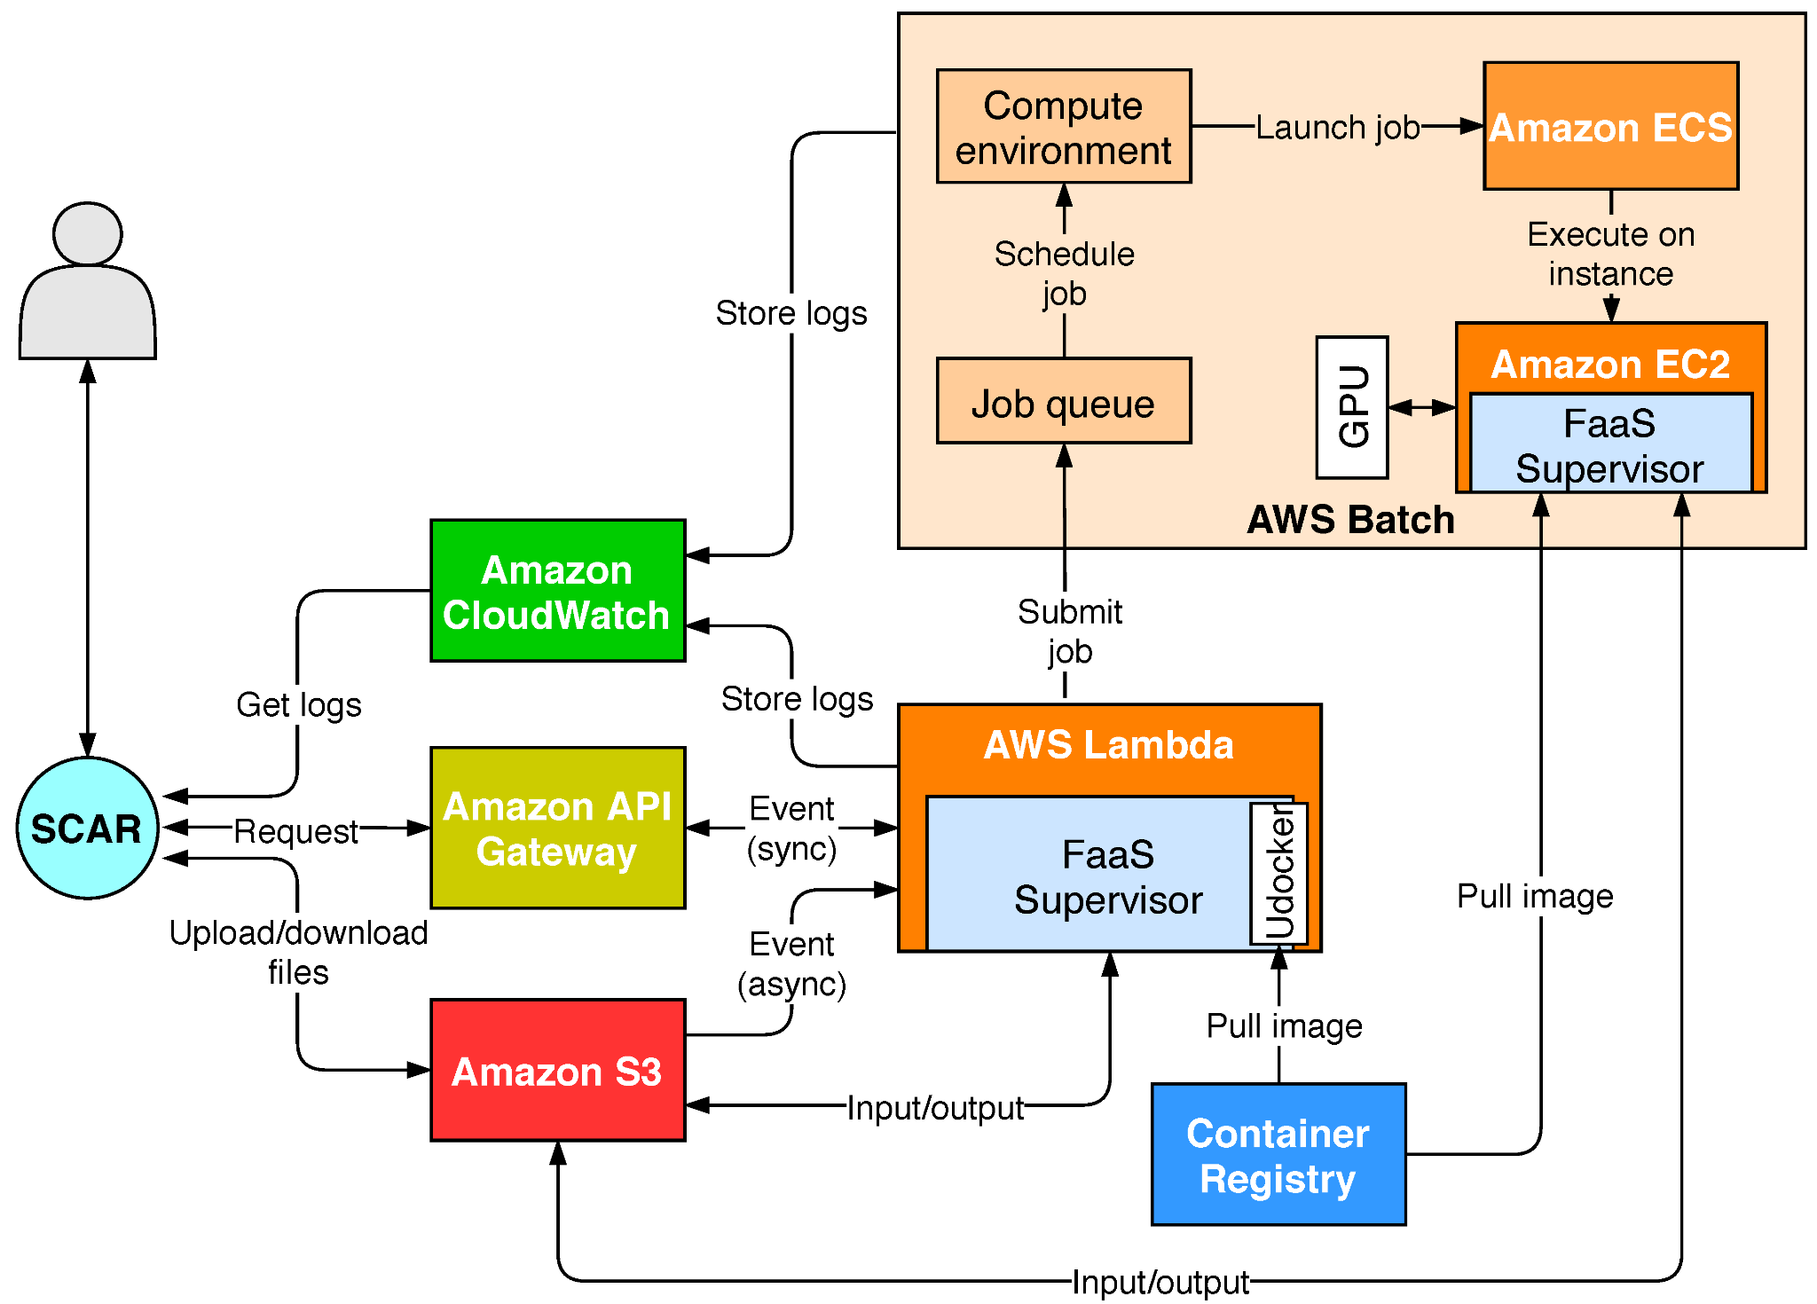
Workflow Examples
AWS Batch integration for long-running and GPU-accelerated jobs
Notes:
AWS Batch runs Docker-based computational jobs on EC2 instances.
The resource requirements of these jobs can be configured by the user in terms of: an increased memory allocation, the assignment of the desired number of CPUs, the instance types to be used and the assignment of GPU devices to containers, among others

Slide 7
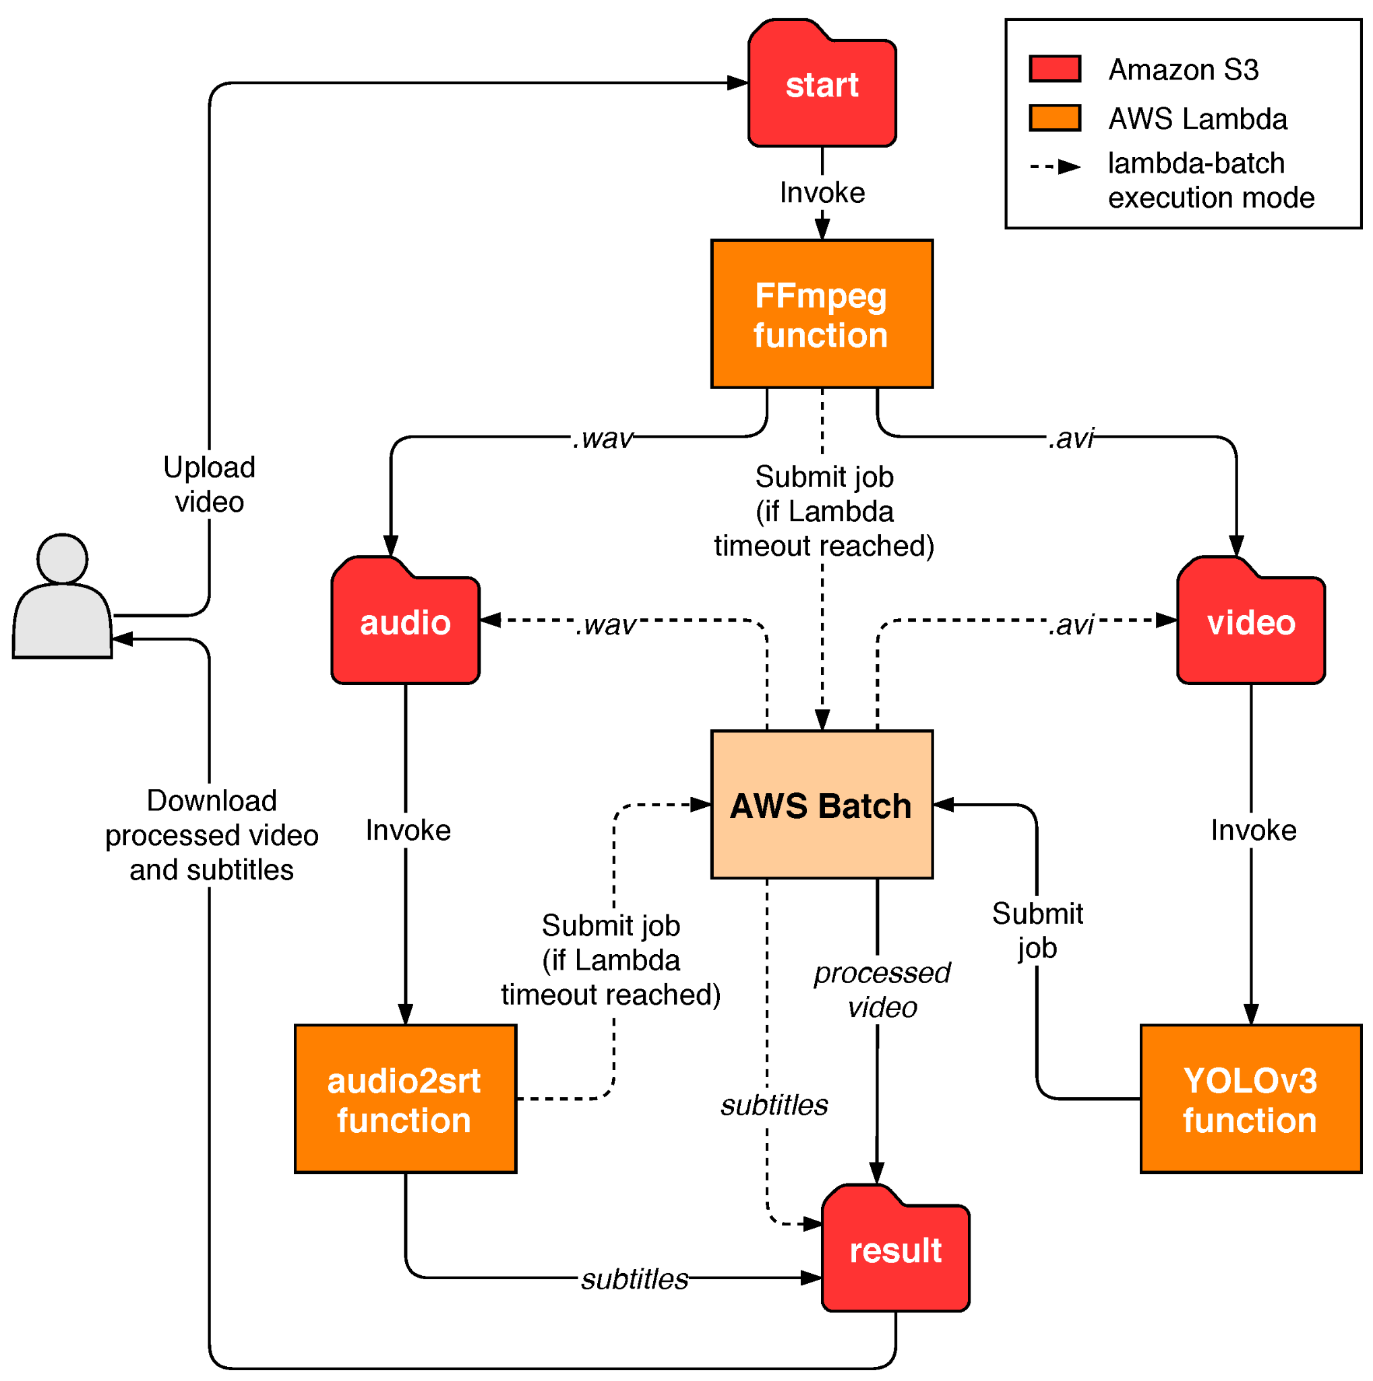
Workflow Examples cont’d
Simplified diagram of the multimedia processing workflow.
Notes:
AWS Batch is composed by several modules that must be defined before the actual execution of jobs:
Compute environment: Computing resources on which the jobs will be executed, described in terms of instance types together with the maximum and minimum number of available nodes of the ECS [24] cluster that will be automatically created. The cluster features elasticity so that additional nodes will be automatically added (up to the maximum number of nodes) depending on the number of pending jobs to be executed and will be automatically terminated when no longer required according to a set of predefined policies enforced by AWS Batch.
Job queue: Managed queues where the jobs are submitted and stored until the compute environment they are assigned to is ready to perform the execution.
Job definition: The basic specification of a job, which includes the Docker image to be used, the number of vCPUs and memory allocated, the request for GPUs, the command to be executed and the environment variables. All jobs must be linked to a job definition. However, jobs can add and modify certain parameters when they are created. AWS Batch automatically executes the jobs that request GPU access with the NVIDIA container runtime.

Slide 8
Recap of Overview
Instances will run only for the necessary time,
can also use spot instances.
Configure how many retries you’d like for any job.
It offers queues where you send the jobs.
Each queue could be configured with a certain priority
Different queues can use different resources.
Docker support
Notes:
Instances will run only for the time that’s needed, taking advantage of the per-second billing. You can also lower your costs by using spot instances.
It’s possible to configure how many retries you’d like for any job.
It offers queues where you send the jobs. Each queue could be configured with a certain priority so you can configure which jobs will run first. You can also have queues that use better resources to speed up the process.
It supports Docker containers so that you can focus only on your code.

Slide 9
Cost
No additional cost
Notes:
You just need to pay for AWS resources such as EC2 instances, AWS Lambda, and AWS Fargate that you use to create, store, and run your application.
You can use your Reserved Instances, Savings Plan, EC2 Spot Instances, and Fargate with AWS Batch by specifying your compute-type requirements when setting up your AWS Batch compute environments.

Slide 10
References
https://aws.amazon.com/batch/
https://intellipaat.com/blog/what-is-aws-batch/
https://stackify.com/aws-batch-guide/
Risco, S., & Moltó, G. (2021). GPU-Enabled Serverless Workflows for Efficient Multimedia Processing. Applied Sciences, 11(4), 1438. https://doi.org/10.3390/app11041438

